Slide 1
Quantum Brainathon-25
EEG Attention Multiclassification Challenge
Enrollment no : G191342481
Name :Vishwajeet kumar

Slide 2
Contents :
data Preparation
Data preprocessing
Feature extraction
Model development
Result

Slide 3
Proposed work:
Data Preprocessing
Feature extraction
Model Implementation

Slide 4
Data set
The dataset set given is first bisected .
EEG channels: 8
Sampling frequency: 256 Hz
The dataset is prepare in a such a way that
"task-switching : 42688 X 8 ", "dual-task : 27688x 8 ", "oddball : 27688x 8", "stroop : 42688 X 8” . For each subject(1-24).
Each of the signal is trimmed into the size 27688b x 8.
The dataset are need to preprocessed through following steps :
Mean average correction
Removal of the ocular artifact using the WICA (which is using fastICA)

Slide 5
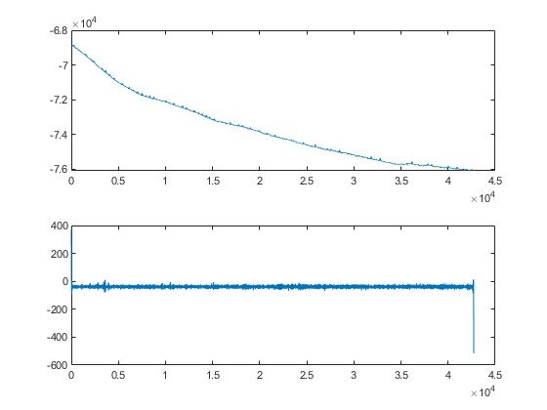
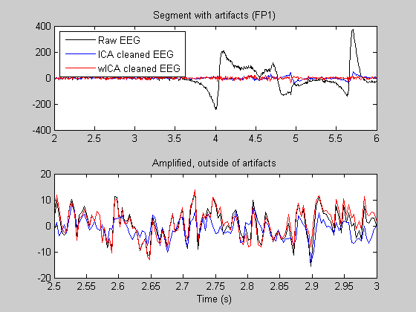
Method of the preprocessing
The dataset are need to preprocessed through following steps :
Mean average correction as the dataset has high impedance (-6.8 x 10⁴).
Removal of the ocular artifact using the WICA (which is using fastICA).

Slide 6
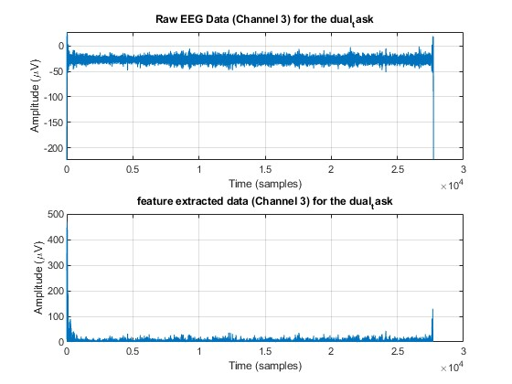
Feature Extraction:
The The EEG signals undergo preprocessing to eliminate noise and artifacts. After this, the signals are converted into visibility graphs, where nodes correspond to data points, and edges are established based on visibility criteria. Edge weights are assigned using a Gaussian kernel, providing a smooth transition between connected nodes.
, the Graph Fourier Transform (GFT) is performed using the eigenvectors of the Laplacian matrix, constructed from the weighted graph. The transformation shifts the graph signals into the spectral domain, where the GFT coefficients are obtained. These coefficients are then used to compute the Power Spectral Density (PSD),

Slide 7
Model :
The EEG signals undergo preprocessing to eliminate noise and artifacts. After this, the signals are converted into visibility graphs, where nodes correspond to data points, and edges are established based on visibility criteria. Edge weights are assigned using a Gaussian kernel, providing a smooth transition between connected nodes.
the Graph Fourier Transform (GFT) is performed using the eigenvectors of the Laplacian matrix, constructed from the weighted graph. The transformation shifts the graph signals into the spectral domain, where the GFT coefficients are obtained. These coefficients are then used to compute the Power Spectral Density (PSD),
EEG TIME SERIES SIGNAL
Preprocessing of Signal
Generation of adjacency matrix
Calculate Laplacian Eigen vector
Power spectral density of GFT coefficient
Classification using QSVC classifier
Assign Edge weight by gaussian Kernal
Graph furrier Transform
task_
switching
dual_
task
oddball
stroop

Slide 8
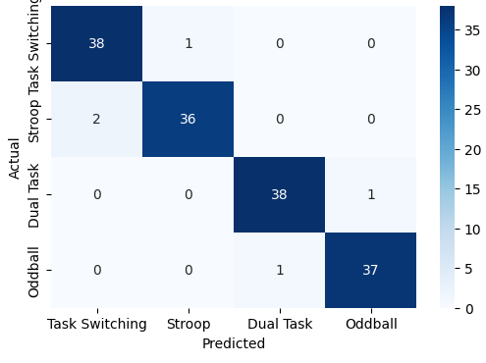
Result for the machine learning classifier
Using the feature of the all four classes the feature is made to be 192x27688 with 8x27688 for the 24 subject "task-switching : 42688 X 8 ", "dual-task : 27688x 8 ", "oddball : 27688x 8", "stroop : 42688 x 8.
Classical SVC (RBF Kernel) Uses a Radial Basis Function (RBF) Kernel for non-linear classification. Well-established in EEG-based machine learning applications. Trained with SciKit-Learn’s SVC model.
using machine learning classifier I got accuracy of more than 98% for the four classes.

Slide 9
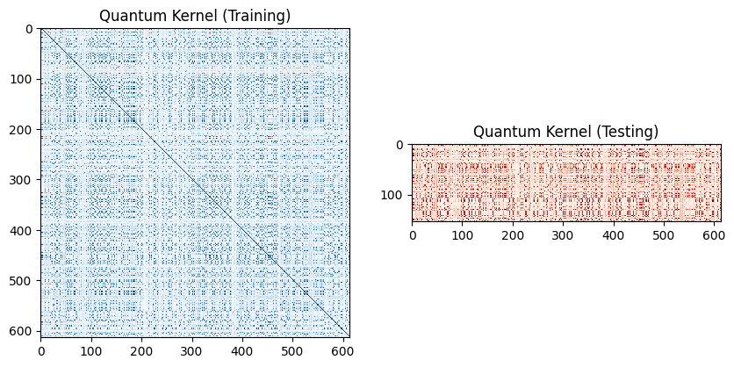
Result for the Quantum machine learning classifier
The Quantum Support Vector Classifier (QSVC) was trained using a Quantum Kernel based on the ZZFeatureMap (entanglement: linear, reps: 2). in Qiskit.
Quantum Kernel based on State Fidelity Computation. Implemented using Qiskit Machine Learning
The generated feature is 80% training vs. 20% testing.

Slide 10
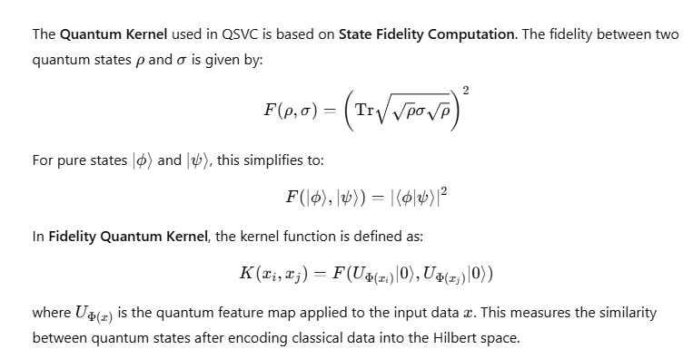
Quantum kernel

Slide 11
QSVC
How QSVC Works
Feature Encoding with Quantum Circuits
Classical EEG features (4 components from PCA) are encoded into quantum states using a ZZFeatureMap, which creates entanglement between qubits.
This quantum feature map transforms the data into a quantum Hilbert space, where non-linear relationships can be better captured.
Quantum Kernel Calculation
Instead of defining a traditional kernel function, QSVC uses a Fidelity Quantum Kernel.
This kernel computes the similarity between quantum-encoded feature vectors using the state fidelity measure.
Higher fidelity values indicate greater similarity in the transformed feature space.
Training with Quantum Kernel SVM
QSVC uses Quantum Kernel Estimation to compute an optimal decision boundary in the quantum feature space.
Classical optimization techniques (like quadratic programming) are then applied to find the support vectors.

Slide 12
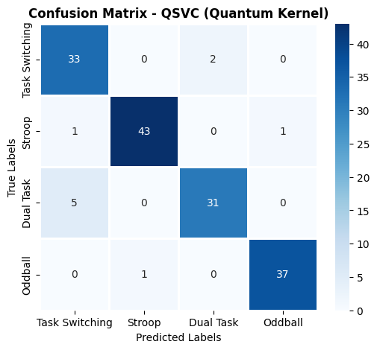
QSVC for EEG Classification
Higher-Dimensional Feature Mapping – Quantum kernels can represent EEG data in a richer feature space than classical methods. Potential for Quantum Advantage – As quantum hardware improves, QSVC could outperform classical SVM in complex datasets. Inherent Non-Linearity – Unlike classical polynomial and RBF kernels, quantum kernels are data-driven and do not require pre-definition.
QSVC Accuracy: 94%

Slide 13
Thank You !

